Slide 1
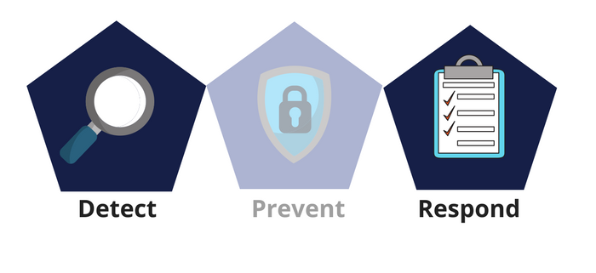



Network Security
Class X
lab 25

Slide 2


Sniffing
monitoring and capturing all the packets passing through a given network using sniffing tools

Slide 3
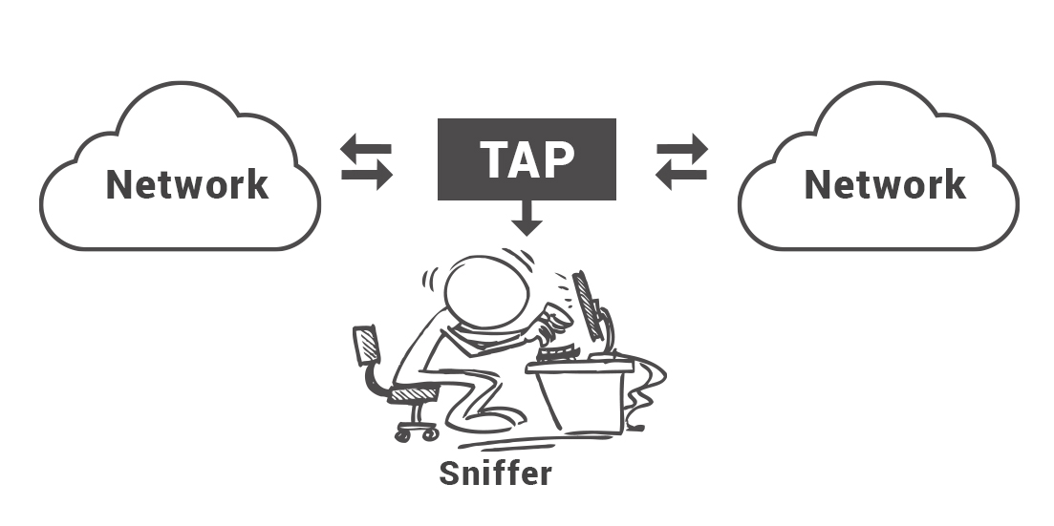
What can be sniffed?
Email traffic
FTP passwords
Web traffics
Telnet passwords
Router configuration
Chat sessions
DNS traffic

Slide 4
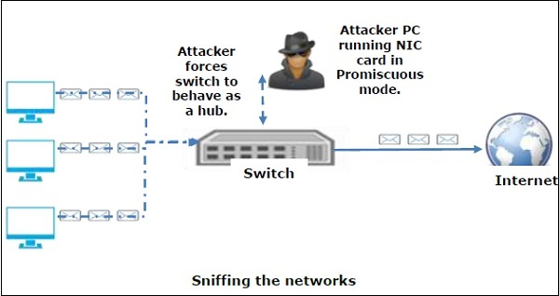
How Sniffing works?
A sniffer normally turns the NIC of the system to the promiscuous mode so that it listens to all the data transmitted on its segment

Slide 5
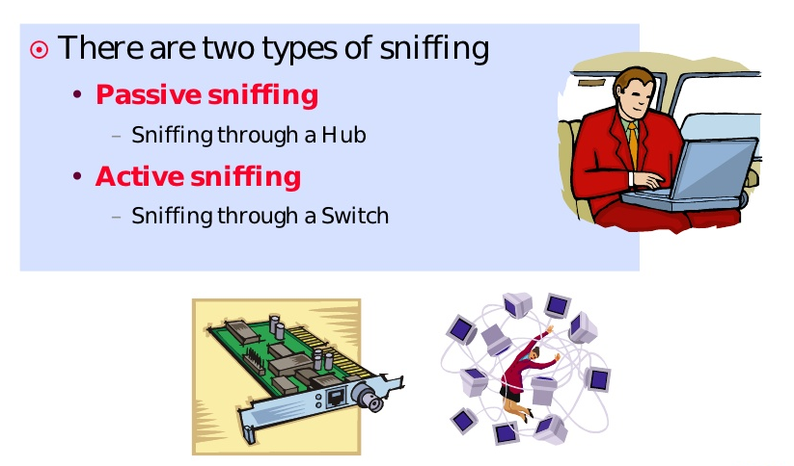
Types of Sniffing

Slide 6
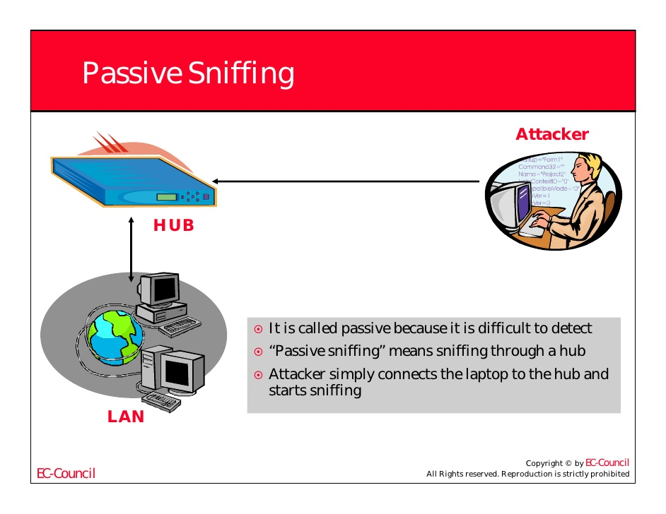
Passive Sniffing

Slide 7
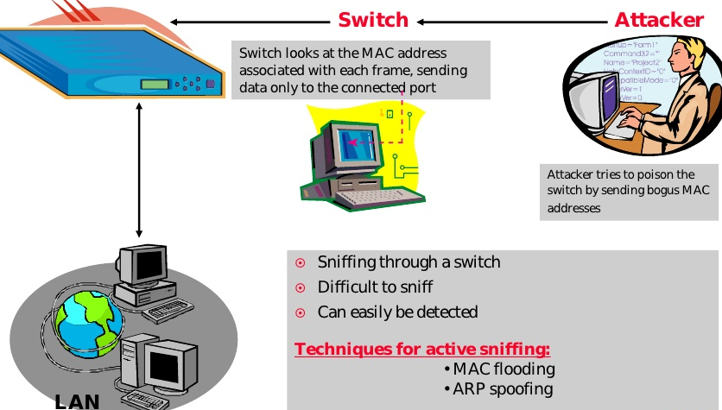
Active Sniffing

Slide 8
Thank You

